Slide 1

Service Groups
What and why?

Slide 2
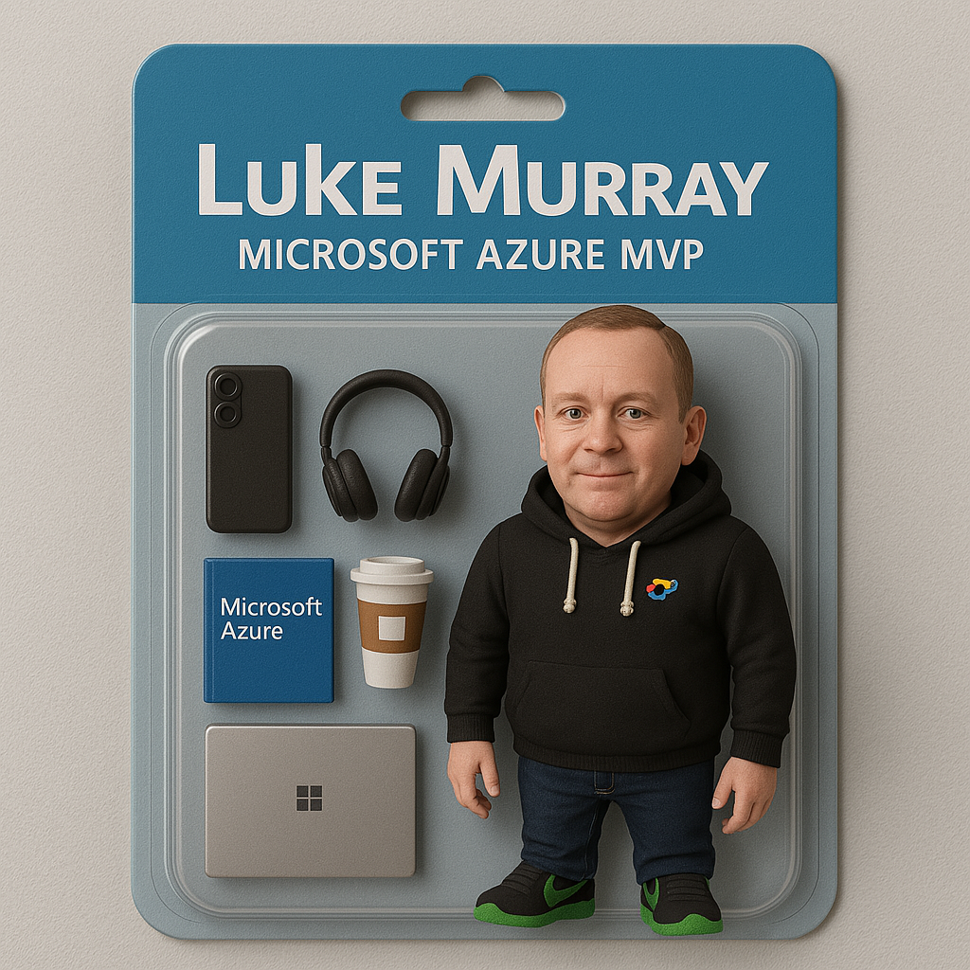



Hello!
Thank you for joining us today
Speaker: Luke Murray
Microsoft Learn Expert and Microsoft Azure MVP, and ISM Service Lead, at HSO from Hamilton, New Zealand.
https://x.com/lukemurraynz
https://www.linkedin.com/in/ljmurray/
https://luke.geek.nz/
https://www.youtube.com/@lukemurraynz

Slide 3



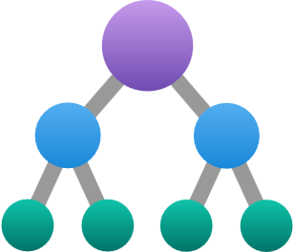
Governance Services
On by default, Azure governance gives platform teams control and developers agility to deploy in Azure
Azure Policy
Azure Resource Graph
Tags
Management Groups
And more….??
Ensure compliance and governance in the cloud with automated, enterprise-wide policy enforcement.
Unlock powerful insights at scale with lightning-fast querying across all your cloud resources
Organize and track your Azure resources effortlessly with customizable, dynamic tags.
Streamline management by grouping and controlling Azure subscriptions with ease.

Slide 4


Challenges with cloud operations at scale
Hierarchy division should align to environment and criticality
Cloud operations team has strict requirements for the hierarchy and tagging of resources. Make sure you tag for proper inventory
We must limit access across subscriptions, but make sure you can alter each resource
Cloud Ops
Please provide a detailed report of the cost for the application all-up
Architecture
Cost Ops
Security
Other roles
?
I need to manage my app across all of this?
?
?
Dev Lead

Slide 5






Today
Tenant Root
Use a mixture of Azure products to differentiate custom groups. Some patterns leveraged are: ​
Naming Conventions ​
Locations​
Tags ​
Resource Groups​
Subscriptions​
Management Groupsps
Management Groups
Subscriptions
Resource Groups
Resources

Slide 6

Governance Services
On by default, Azure governance gives platform teams control and developers agility to deploy in Azure
NEW!
Azure Policy
Azure Resource Graph
Tags
Management Groups
Service Groups
Ensure compliance and governance in the cloud with automated, enterprise-wide policy enforcement.
Unlock powerful insights at scale with lightning-fast querying across all your cloud resources
Organize and track your Azure resources effortlessly with customizable, dynamic tags.
Streamline management by grouping and controlling Azure subscriptions with ease.
Flexible aggregation information from cross-subscription resources and scopes.

Slide 7

One product, many scenarios
Groups
Applications
Services
Workloads
All enabled through
Service Groups

Slide 8

Service Groups
Tenant
Root SG
Root MG
Service Groups are a new group that enable flexible, cross subscription, and hierarchical grouping within Azure.
They enable separate persona and scenario structuring based on your needs.
A Service Group is not a deployment scope nor supports Policy/RBAC inheritance to its members.
Corporation
Division
Division
Non-Production
Prod
Sub-Department
Department
Service Groups
Team
Team
Team
Team
Service

Slide 9
Service Groups Features
Hierarchy
Flexibility
Aggregation
Multiple different branches and trees outside the Governance Resource Hierarchy
Support up to 10 levels below the Root Service Group
Members can be from multiple different subscriptions
Resources, Resource Groups, and Subscriptions can be members of multiple Service Groups
Aggregate data from resources across subscriptions for practical workloads
View application health, costs, or other important data values centered around your wanted perspectives

Slide 10
Service Groups vs other scopes
 | Deployment Scope | Policy and RBAC inheritance | Privilege | Can be Nested | Flexible membership
Service Group | No | No | Least | Yes | Yes
Management Group | Yes | Yes | High | Yes | No
Subscription | Yes | Yes | High/Varies | No | No
Resource Group | Yes | Yes | Varies | No | No

Slide 11
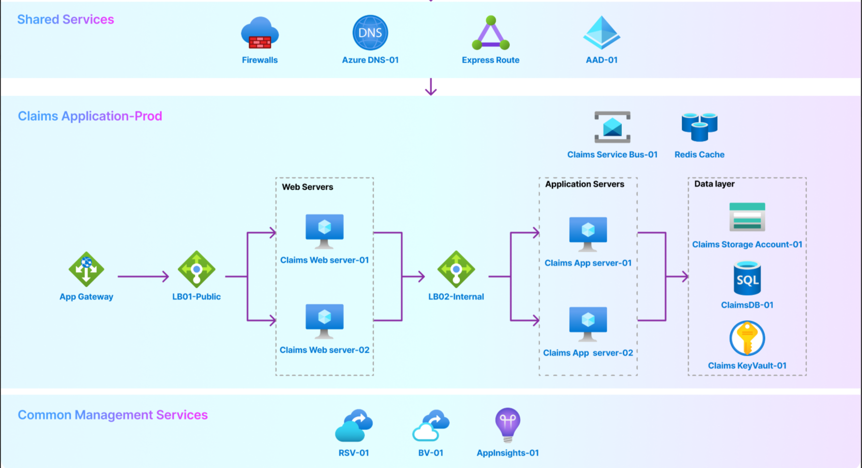

Slide 12







Contoso Tenant Root
Contoso
Contoso Insurance
Non-Prod
Prod
Insurance Applications
Contoso’s goal is to leverage the new groups called “Service Groups” that will allow them to model their internal application catalog in Azure
Claims Application
Shared
Services
NonProd
Management
Services
Prod
Claims-Prod-EUS

Slide 13
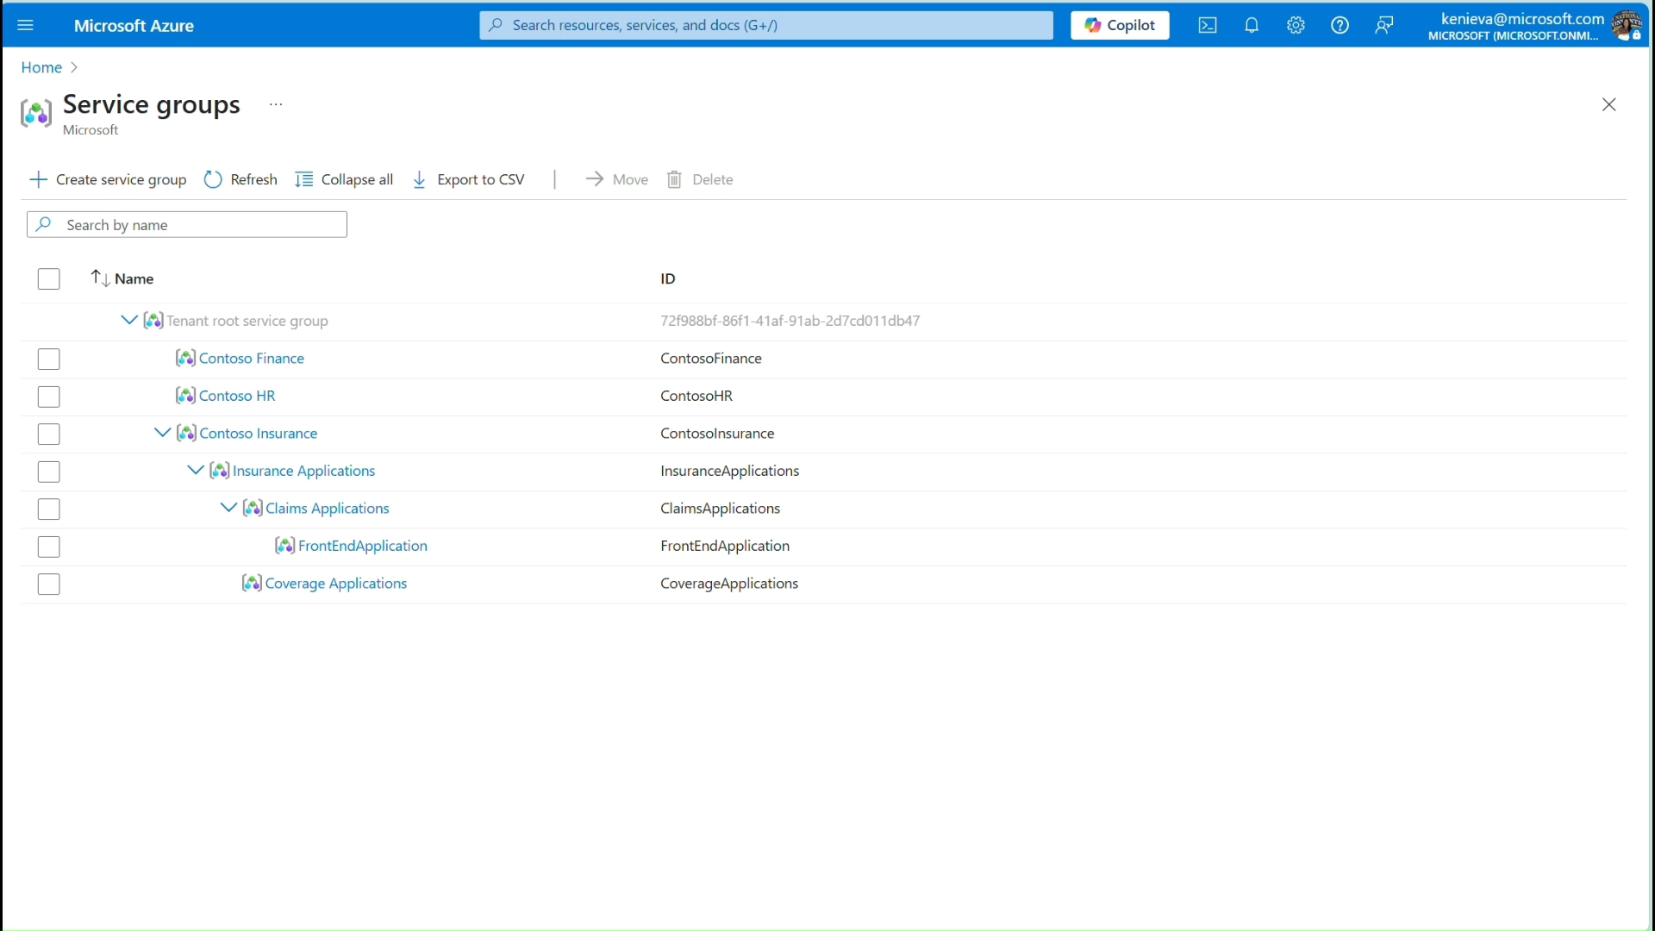
Demo

Slide 14
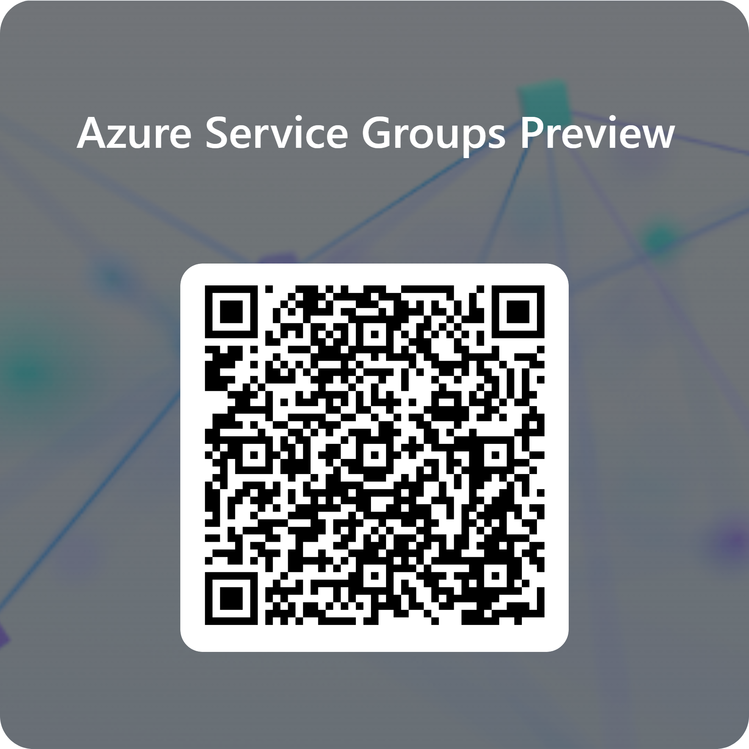
Enable Service Groups for your tenant!
Onboard to the limited public preview here: https://aka.ms/SGP

